Slide 1
SmartHealth
AI in Health Care

Slide 2
Rural Healthcare Crisis in India – Key Facts
📌 75% of deaths in India occur at home without medical attention. (Million Death Study)
📌 Severe Doctor Shortage – The doctor-to-patient ratio in rural India is 1:10,926, far below the WHO standard of 1:1000. 📌 High Mortality Due to Lack of Medical Attention – 75% of deaths occur at home without medical help. 📌 Expensive & Limited Diagnostic Facilities – Many villages lack proper lab testing and imaging centers, delaying critical diagnoses. 📌 Poor Disease Prevention Awareness – Lack of education on basic health, first aid, and early disease detection leads to preventable deaths..

Slide 3
Key Features
📌 Lab-Test Reports – Users can upload and analyze medical test reports for AI-based insights.
📌 Image Analysis – AI-powered analysis of X-rays, scans, and other medical images for disease detection.
📌 Lifestyle Tips – Personalized recommendations for a healthier life based on user health data.
📌 First Aid Basics – Quick access to essential first-aid guidance for common medical emergencies.
📌 Find Nearby Hospitals – A contact page that locates hospitals based on the user's location.

Slide 4
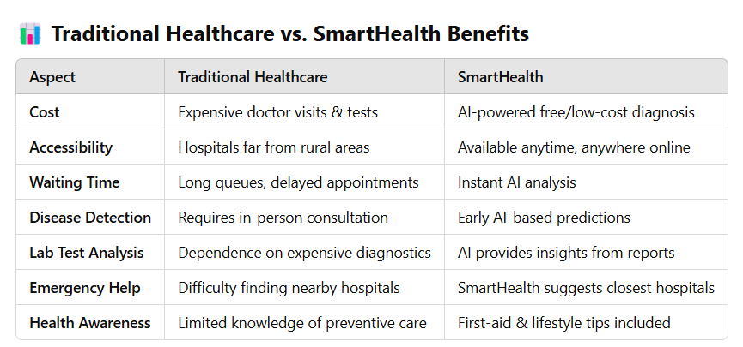

Slide 5
Image Upload – The user uploads an image (X-ray, skin scan, etc.).
Feature Extraction – The model extracts objects, text, patterns, and contextual details.
Multimodal Fusion – If a text query is provided, the model links visual and textual information.
Inference & Analysis – It classifies, detects objects, extracts text (OCR), or answers questions.
Response Generation – The model provides insights, diagnoses, or explanations.
Output Delivery – The system returns results with recommendations or follow-up actions.

Slide 6
Thank you

